Slide 1



Gov Service Portal
Egypt Government Service Portal for citizens built on ServiceNow
Egypt Government Service Portal
Prepared By:
Marvy Adel

Slide 2
Introduction
Government services are an essential part of citizens' daily lives. However, many traditional government processes still rely on manual procedures, paper-based forms, and in-person visits, which can result in long waiting times, limited transparency, and difficulties in tracking service requests.
To address these challenges, digital transformation has become a key objective for modern governments. Providing citizens with online access to government services improves efficiency, accessibility, and user satisfaction while reducing administrative effort.
The Egypt Government Service Portal is a citizen-centric platform developed on the ServiceNow platform to streamline the delivery of government services. The portal enables citizens to register, submit service requests, track application status, book appointments, submit complaints, and share recommendations through a unified digital experience.
The project aims to enhance communication between citizens and government departments by providing a secure, transparent, and user-friendly self-service portal. By leveraging ServiceNow's capabilities, the solution demonstrates how modern workflow automation and digital services can improve the overall citizen experience.

Slide 3
# | Table Label | Table Name | Extends | Purpose
1 | Citizen Profile | x_1970971_egypt_0_citizen_profile | Nothing | Stores all citizen personal data and portal identity
2 | Government Department | x_1970971_egypt_0_government_department | Nothing | Master data for government departments
3 | Citizen Request | x_1970971_egypt_0_citizen_request | task | Main service request — inherits SLA, approvals, assignment from Task
4 | Appointment | x_1970971_egypt_0_appointment | Nothing | Citizen appointments with government departments
5 | Recommendation List | x_1970971_egypt_0_list_of_recommendations | Nothing | To be in the Portal and all Citizen Could See The other Recommendations
6 | Complaint | x_1970971_egypt_0_complaint | task | Citizen complaints — inherits SLA and assignment from Task
7 | Complaint Feedback | x_1970971_egypt_0_complaint_feedback | Nothing | Citizen satisfaction rating after complaint resolution
8 | Recommendation | x_1970971_egypt_0_recommendation | Nothing | Citizens submit improvement suggestions with public voting
9 | Recommendation Vote | x_1970971_egypt_0_recommendation_vote | Nothing | Tracks one vote per citizen per recommendation

Slide 4
Group Name | Assigned Role | Purpose
EgyptGov - Citizens | x_1970971_egypt_0.citizen | All registered portal users
EgyptGov - Agents | x_1970971_egypt_0.agent | Government service agents
EgyptGov - Dept Managers | x_1970971_egypt_0.dept_manager | Department heads and approvers
EgyptGov - Admins | x_1970971_egypt_0.admin | System administrators
EGYPTGOV-Complaint Handler | x_1970971_egypt_0.complaint_handler | Complaints Solvers

Slide 5


MAP
Phase 3
Phase 1
Phase 4
Phase 2

Slide 6
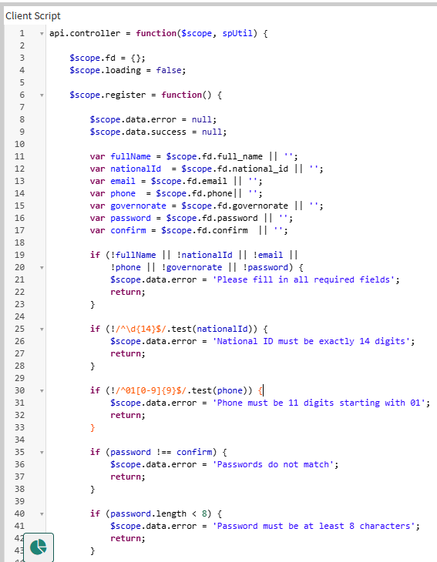
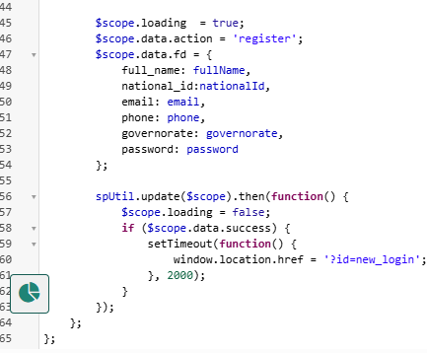
Phase 1
Registration & Sign in
Sign in is a clone from OOTB widget called sign in

Slide 7
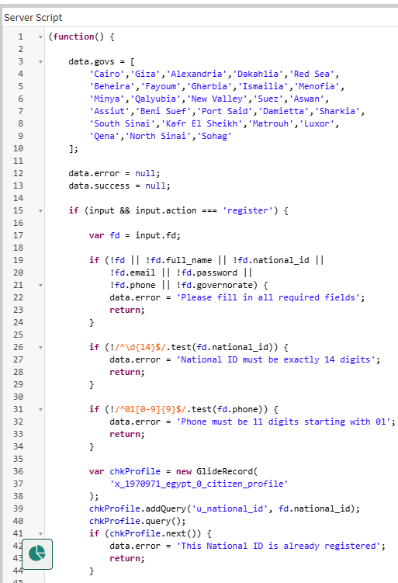
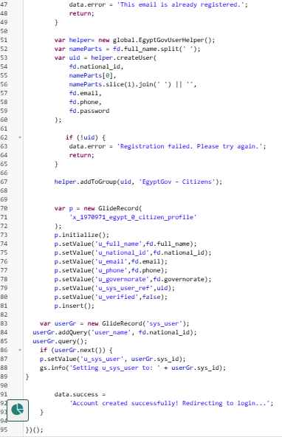

Slide 8
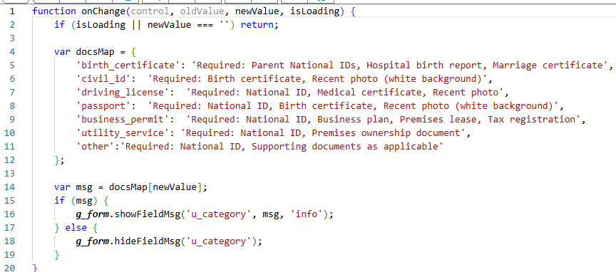
Submit Request : there is a flow (request lifecycle manage this)
Is a Record Producer using cs_catalog OOTB Widget
Client Script (OnChange) on record producer to show the Requirements

Slide 9
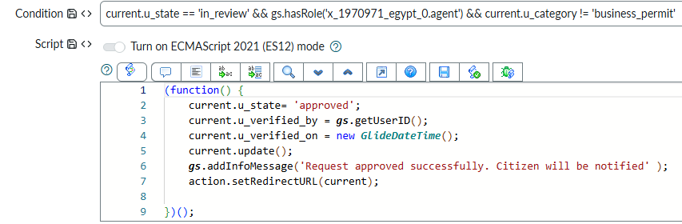
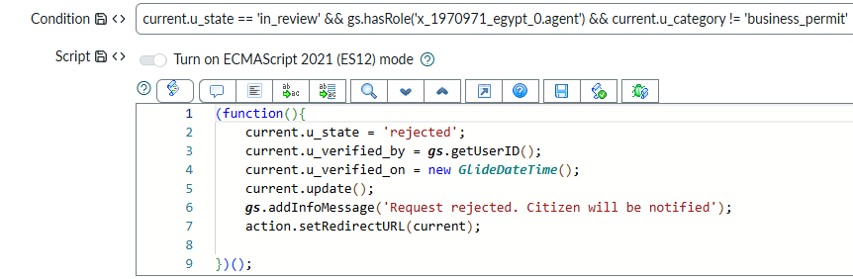
Agent & Manager Side:
UI Action Buttons:
Approval Button
Rejection Button

Slide 10
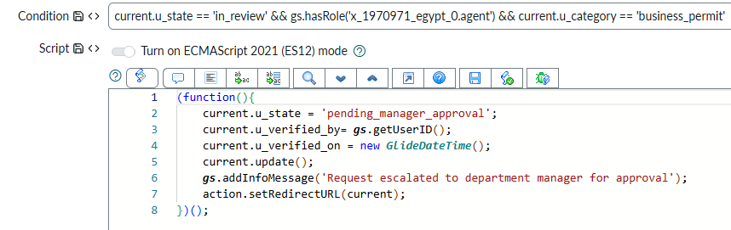
Agent & Manager Side:
UI Action Buttons: there is a hierarchy approval for Business Permit
Escalate To Manager Button

Slide 11
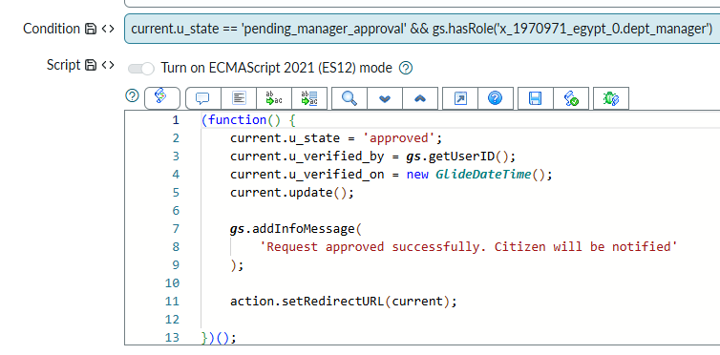
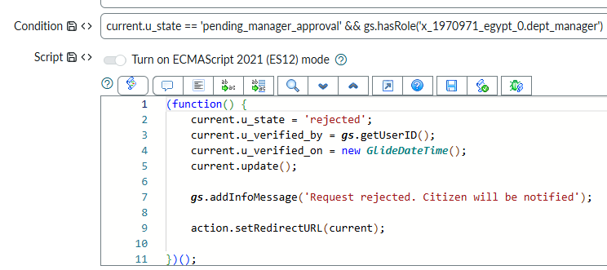
Agent & Manager Side:
UI Action Buttons: there is a hierarchy approval for Business Permit
Manager Approve Request
Manager Reject Request

Slide 12
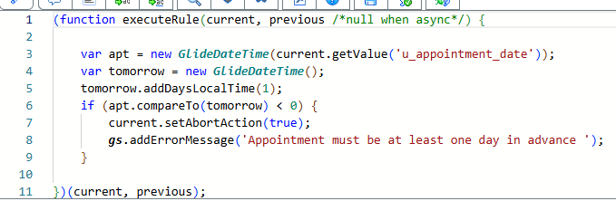
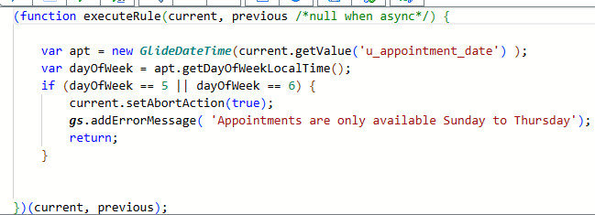
If the Request Approved:
(Appointment Lifecycle)
BR: prevent putting an old date (before insert & update)
BR: Available time slots (before insert & update)

Slide 13
MAP
Phase 3
Phase 1
Phase 4
Phase 2

Slide 14
Phase 2
Complaint Lifecycle
Created by a Record Producer using cs_catalog OOTB Widget
Demo Complaint Lifecycle Flow

Slide 15
MAP
Phase 3
Phase 1
Phase 4
Phase 2

Slide 16
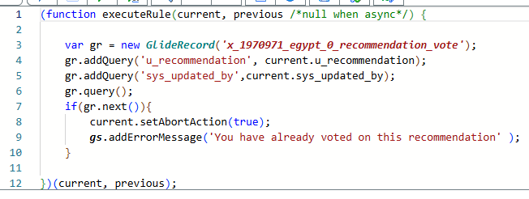
Phase 3
Recommendation Lifecycle
Created by a Record Producer using cs_catalog OOTB Widget
Recommendation vote:
BR: One Vote Ber Citizen (BEFORE Insert)

Slide 17
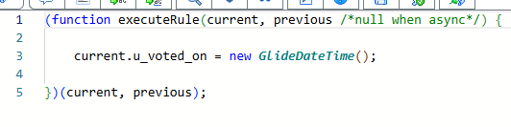
BR: auto Set Voted On:
Recommendation List: (handled with Flow)
OOTB widget :Data Table from Instance Definition

Slide 18
MAP
Phase 3
Phase 1
Phase 4
Phase 2

Slide 19
Phase 4
My Applications:
Created BY OOTB widget called ‘ My Request’
To store all the complaints Records
Dashboard Take a look on it

Slide 20
MAP
Phase 3
Phase 1
Phase 4
Phase 2

Slide 21
THANK YOU

